Slide 1


Exploring the Frontiers of Generative AI: Text, Vectors, and Beyond
Welcome to an exciting journey into the world of Generative AI, where we'll dive deep into the realms of text generation, vector databases, and hands-on applications. This comprehensive exploration is designed for data scientists, machine learning engineers, and software developers who are ready to push the boundaries of AI technology.
We'll start by unraveling the intricacies of Large Language Models, delve into the power of vector databases, and finally, get our hands dirty with advanced generative AI techniques. By the end of this presentation, you'll have a robust understanding of cutting-edge AI technologies and practical skills to implement them in your projects.
by Dr. Tri Basuki Kurniawan

Slide 2
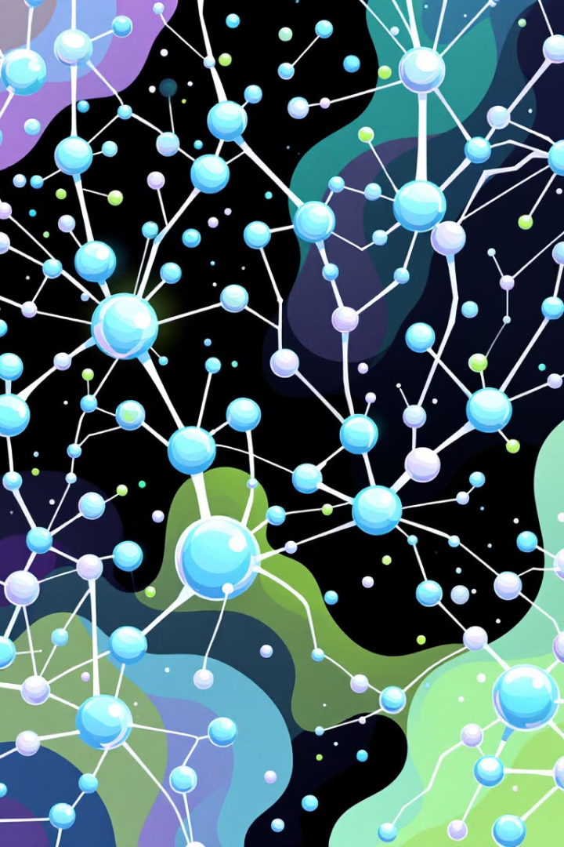
Large Language Models: The Foundation of Text AI
Large Language Models (LLMs) have revolutionized the field of natural language processing. These sophisticated neural networks are trained on vast amounts of text data, enabling them to understand and generate human-like text with remarkable accuracy. LLMs like GPT (Generative Pre-trained Transformer) have set new benchmarks in language understanding and generation tasks.
The power of LLMs lies in their ability to capture complex linguistic patterns and semantic relationships. They can generate coherent paragraphs, complete unfinished sentences, and even engage in dialogue. The continuous advancements in LLM architecture and training techniques have led to models that can perform a wide range of language tasks with minimal fine-tuning.
1
Data Collection
Gathering diverse and high-quality text data from various sources
to train the model.
2
Pre-training
Training the model on a large corpus of text to learn general
language understanding.
3
Fine-tuning
Adapting the pre-trained model to specific tasks or domains
for improved performance.
4
Deployment
Integrating the fine-tuned model into applications for real-world
use.

Slide 3

Key Concepts: Tokens, Embeddings, and Attention Mechanisms
To truly understand LLMs, we must grasp the fundamental concepts that power them. Tokens are the basic units of text that LLMs process, typically words or subwords. Embeddings are dense vector representations of these tokens, capturing semantic relationships in a high-dimensional space. Attention mechanisms allow the model to focus on relevant parts of the input when generating output, greatly enhancing its ability to understand context.
These concepts work together to enable LLMs to process and generate text effectively. Tokenization breaks down text into manageable units, embeddings provide a rich representation of language, and attention mechanisms help the model prioritize important information during processing.
Tokens
Embeddings
Discrete units of text (words or subwords) that serve as input to the model. Tokenization helps in handling out-of-vocabulary words and reduces the model's vocabulary size.
Dense vector representations of tokens that capture semantic meaning. These allow the model to understand relationships between words in a continuous space.
Attention Mechanisms
Techniques that allow the model to focus on different parts of the input when generating output. This enables better handling of long-range dependencies in text.

Slide 4

Text Generation and Completion
Text generation and completion are among the most impressive capabilities of LLMs. These models can produce human-like text on a wide range of topics, complete unfinished sentences, and even write entire articles or stories. The process involves feeding the model a prompt or partial text and letting it generate the most likely continuation based on its training data.
Applications of text generation and completion are vast and diverse. They range from creative writing assistance and content creation to code completion for programmers and automated report generation. The key to successful text generation lies in crafting effective prompts and fine-tuning models for specific use cases.
Creative Writing
Generating stories, poems, and scripts to assist authors and content
creators.
Code Completion
Suggesting and completing code snippets to enhance the programmer
productivity.
Content Generation
Creating articles, product descriptions, and marketing copy at scale.
Text Completion
Finishing partial sentences or paragraphs in various contexts, from
emails to academic writing.

Slide 5





Machine Translation and Summarization
Machine translation and summarization are two critical applications of LLMs that have transformed how we process and understand multilingual content. Modern machine translation systems, powered by neural networks, can produce highly accurate translations across numerous language pairs. These systems go beyond word-for-word translation, capturing context and nuances to deliver more natural-sounding results.
Text summarization, on the other hand, involves condensing long documents into shorter, coherent versions while retaining key information. LLMs excel at both extractive summarization (selecting important sentences) and abstractive summarization (generating new sentences to capture the essence of the text). These technologies have wide-ranging applications, from making foreign language content accessible to quickly digesting large volumes of information.
Input Processing
Context Analysis
Tokenizing and encoding the source text or document.
Understanding the overall meaning and key points of the input.
Translation/Summarization
Refinement
Generating the target language output or concise summary.
Post-processing to ensure coherence and accuracy of the final output.

Slide 6





Conversational Agents and Chatbots
Conversational AI, in the form of intelligent chatbots and virtual assistants, has become an integral part of modern digital interactions. These AI-powered agents can engage in human-like dialogue, answer questions, and perform tasks across various domains. LLMs have significantly enhanced the capabilities of these systems, enabling more natural and context-aware conversations.
Advanced conversational agents can maintain context over long interactions, understand and generate nuanced responses, and even exhibit a sense of personality. They find applications in customer service, healthcare (as mental health chatbots), education (as tutoring assistants), and personal productivity tools. The key challenges in developing effective conversational AI include maintaining coherence, handling ambiguity, and ensuring ethical and unbiased responses.
Natural Language Understanding
Task Completion
Interpreting user intents and extracting
relevant information from inputs.
Executing user requests and providing
relevant information or actions.
Contextual Awareness
Personalization
Maintaining conversation history and
adapting responses based on context.
Adapting conversation style and
content to individual user preferences.

Slide 7

Sentiment Analysis with LLMs
Sentiment analysis, the task of determining the emotional tone behind a piece of text, has been revolutionized by Large Language Models. Traditional approaches relied heavily on predefined lexicons and rule-based systems. In contrast, LLMs can capture subtle nuances, context-dependent sentiments, and even detect sarcasm or irony with remarkable accuracy.
These advanced models can perform fine-grained sentiment analysis, going beyond simple positive/negative classifications to detect specific emotions, intensity levels, and aspects of sentiment. This capability is invaluable in various applications, from brand monitoring and customer feedback analysis to social media trend tracking and market research. LLMs can also adapt to domain-specific language and evolving linguistic patterns, making them highly versatile for sentiment analysis tasks across different industries and contexts.

Slide 8

Vector Databases: Powering Efficient AI Retrieval
Vector databases have emerged as a crucial component in the AI ecosystem, particularly for managing and querying high-dimensional data such as text embeddings. Unlike traditional databases that store scalar values, vector databases are optimized for similarity searches in multidimensional spaces. This makes them ideal for applications involving semantic search, recommendation systems, and content retrieval in AI models.
The power of vector databases lies in their ability to perform fast approximate nearest neighbor (ANN) searches, which is essential for finding similar items in large datasets. They use specialized indexing structures like HNSW (Hierarchical Navigable Small World) or IVF (Inverted File) to enable efficient querying. As AI models increasingly rely on dense vector representations, vector databases have become indispensable for scaling AI applications and improving response times.
1
Efficient Similarity Search
Vector databases excel at finding similar items in high-dimensional spaces, crucial for semantic matching and recommendation systems.
2
Scalability
They can handle billions of vectors, making them suitable for large-scale AI applications and big-data scenarios.
3
Low Latency
Optimized for fast querying, vector databases enable real-time AI applications with quick response times.
4
Flexibility
Support for various distance metrics and indexing methods allows customization for specific use cases and data types.

Slide 9
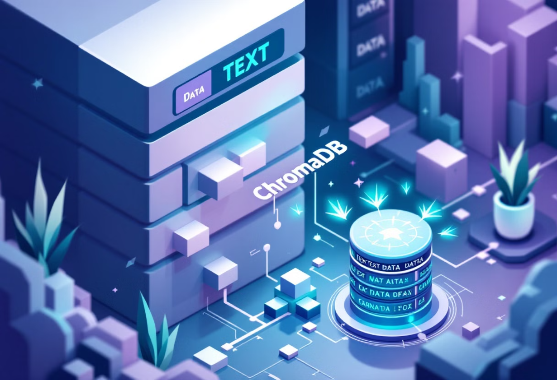
Implementing ChromaDB in Generative AI
ChromaDB is an open-source vector database that has gained popularity in the Generative AI community due to its simplicity and efficiency. It provides a Python-first API that seamlessly integrates with popular machine learning frameworks, making it an excellent choice for AI developers and researchers. ChromaDB supports various embedding models and distance metrics, allowing for flexible and customized implementations.
Implementing ChromaDB in a Generative AI pipeline typically involves several steps: first, generating embeddings from your text data using a suitable model (e.g., BERT or GPT); then, storing these embeddings in ChromaDB along with their associated metadata. Once the data is ingested, you can perform similarity searches, filter results based on metadata, and even update or delete entries dynamically. ChromaDB's efficient indexing ensures fast query times, even with large datasets, making it suitable for real-time AI applications.
1
2
Data Preparation
Embedding Generation
Cleaning and preprocessing text data for embedding generation.
Using a pre-trained model to create vector representations of the text.
3
4
ChromaDB Integration
Query Implementation
Storing embeddings and metadata in the ChromaDB instance.
Developing similarity search and filtering logic for AI applications.

Slide 10

Data Ingestion and Chunking in Vector Databases
Effective data ingestion and chunking are crucial for optimal performance in vector databases. The ingestion process involves converting raw data into a format suitable for vector storage, typically involving text embedding generation. Chunking, on the other hand, refers to breaking down large documents or datasets into smaller, manageable pieces that can be independently embedded and stored.
Proper chunking strategies can significantly impact the quality of retrieval results. For text data, this might involve splitting documents into paragraphs or semantic units rather than arbitrary character counts. Advanced techniques like sliding window approaches or semantic segmentation can further improve the coherence of chunks. During ingestion, it's also important to consider metadata storage alongside vectors, as this enables more nuanced filtering and retrieval operations later on.
Text Preprocessing
Cleaning, tokenizing, and normalizing text data to ensure consistency in vector representations.
Chunking Strategies
Implementing intelligent document splitting techniques to create meaningful and coherent text chunks.
Metadata Handling
Storing relevant metadata alongside vectors to enable advanced filtering and contextualization.

Slide 11





Querying and Retrieval in Vector Databases
Querying and retrieval are the core operations in vector databases that enable AI models to find relevant information efficiently. The process typically starts with converting the query (often in natural language) into a vector representation using the same embedding model used during ingestion. The database then performs a similarity search to find the closest matching vectors in its index.
Advanced querying techniques in vector databases go beyond simple nearest neighbor searches. They may involve hybrid searches that combine vector similarity with metadata filtering, allowing for more precise and contextually relevant results. Some systems also support semantic caching to speed up frequent queries. The retrieval process often includes post-processing steps such as re-ranking results based on additional criteria or aggregating information from multiple retrieved chunks.
Query Embedding
Converting the input query into a vector representation.
Similarity Search
Finding the closest matching vectors in the database.
Metadata Filtering
Applying additional filters based on stored metadata.
Result Ranking
Ordering and potentially re-ranking the retrieved results.

Slide 12
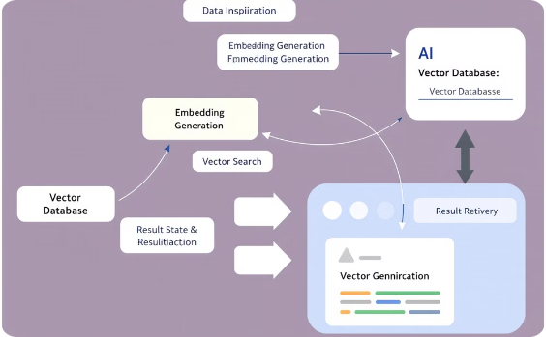

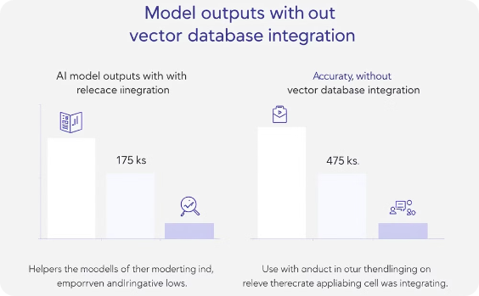
Integrating Vector Databases with AI Models
The integration of vector databases with AI models creates powerful systems capable of enhanced understanding and generation. This synergy is particularly evident in retrieval-augmented generation (RAG) systems, where LLMs are combined with vector databases to produce more accurate and contextually relevant outputs. The vector database serves as an external knowledge base, allowing the AI model to access and incorporate relevant information beyond its training data.
In a typical integration, the AI model generates a query vector based on the input prompt. This vector is used to retrieve relevant information from the database. The retrieved content is then injected into the model's context window, allowing it to generate responses that are both coherent and factually grounded. This approach significantly improves the model's ability to handle domain-specific queries, stay up-to-date with recent information, and reduce hallucinations or factual errors in its outputs.
Integration Architecture
Query Expansion
Performance Improvement
Diagram illustrating the flow of data between the AI model and vector database components.
Visualization of how retrieved information expands the AI model's context for improved generation.
Comparative results demonstrating the enhanced output quality achieved through integration.

Slide 13

Hands-On: Implementing Text Generation with GPT
Implementing text generation using a pre-trained GPT model involves several key steps. First, you'll need to choose and set up a suitable GPT model, such as GPT-3 or an open-source alternative like GPT-J. The implementation typically uses a machine learning framework like PyTorch or TensorFlow, along with high-level libraries such as Hugging Face's Transformers for easier model handling.
The core of the implementation involves crafting effective prompts to guide the model's output. This includes techniques like few-shot learning, where you provide examples in the prompt to steer the model's behavior. You'll also need to experiment with generation parameters such as temperature and top-k sampling to control the
creativity and coherence of the output. Advanced implementations might involve fine-tuning the model on domain-specific data or implementing safety checks to ensure appropriate content generation.
1
Model Setup
Installing dependencies and loading the pre-trained GPT model.
2
Prompt Engineering
Crafting effective prompts to guide the model's output.
3
Parameter Tuning
Adjusting generation settings for desired output characteristics.
4
Output Processing
Post-processing and validating the generated text.

Slide 14

Exploring Image Generation with GANs and Diffusion Models
Image generation has made remarkable strides with the advent of Generative Adversarial Networks (GANs) and, more recently, diffusion models. GANs operate on the principle of adversarial training, where a generator network creates images and a discriminator network tries to distinguish real from fake. This competition drives the generator to produce increasingly realistic images. Diffusion models, on the other hand, learn to reverse a gradual noising process, reconstructing images from noise.
Implementing image generation involves choosing an appropriate architecture (e.g., StyleGAN for GANs or DALL-E for diffusion models), preparing a dataset, and training the model. For hands-on exploration, you might start with pre-
trained models and focus on techniques like style mixing in GANs or prompt engineering in text-to-image diffusion models. Advanced projects could involve fine-tuning models on specific datasets or experimenting with conditional generation to control image attributes.
GAN Architecture
Understanding the generator and discriminator
network structures and their interplay.
Diffusion Process
Exploring the forward and reverse diffusion steps in
noise-based generation.
Training Dynamics
Managing the delicate balance in GAN training or the
denoising process in diffusion models.
Evaluation Metrics
Implementing measures like Inception Score or FID
to assess generated image quality.

Slide 15





Audio and Music Synthesis with AI
Audio and music synthesis using AI models like WaveNet or Jukebox represents a fascinating frontier in generative AI. These models can generate realistic audio waveforms, ranging from human-like speech to complex musical compositions. WaveNet, developed by DeepMind, uses dilated causal convolutions to model the probability distribution of audio samples. Jukebox, created by OpenAI, can generate music in various genres, complete with vocals.
Implementing audio synthesis involves working with specialized libraries for audio processing and neural network architectures designed for sequential data. A typical project might start with preprocessing audio data, encoding
it into a suitable representation (e.g., mel spectrograms), and then training or fine-tuning a model to generate new audio samples. Advanced implementations could explore conditioning the generation on specific instruments, genres, or even lyrics, opening up exciting possibilities for creative applications in music production and sound design.
Audio Preprocessing
Music Theory Integration
Converting raw audio to suitable
representations for AI processing.
Incorporating musical structure and
theory into the generation process.
Model Architecture
Output Synthesis
Implementing specialized neural
networks for audio generation.
Converting model outputs back into
audible waveforms.

